Slide 1

WEEK2 PROGRAM 1 ADDERS
Aim of the Experiment:
Design and Implementation of a Full adder using
Basic Gates

Slide 2
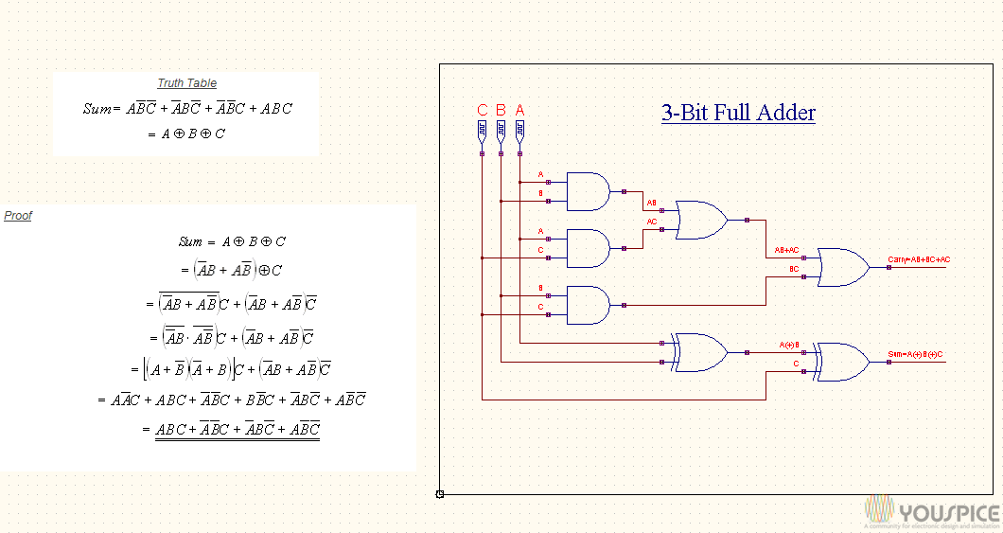
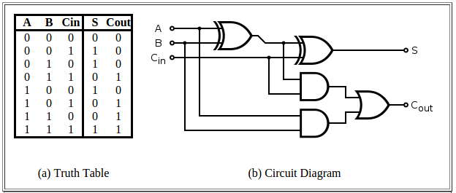
Full Adder
t[1]
t[4]
cout
t[2]
t[3]
t[0]
t[0]
sum
cin

Slide 3
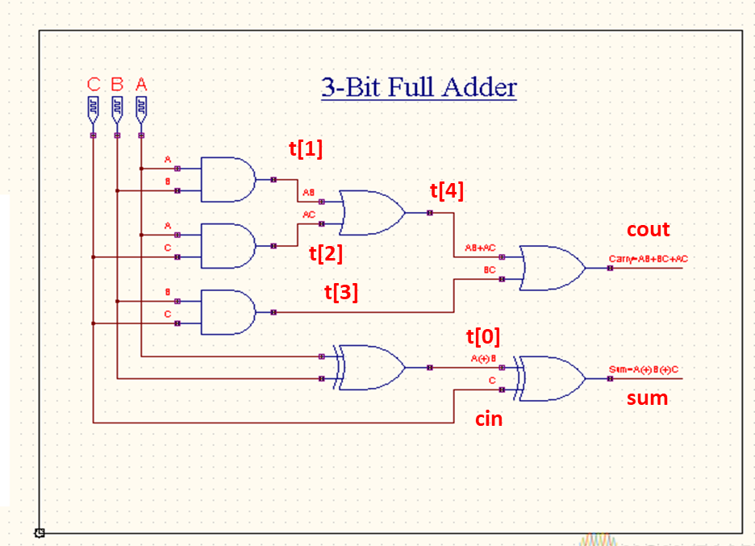
Full Adder Verilog File fulladd.v
module fulladd(input wire a, b, cin, output wire sum, cout);
wire [4:0] t;
xor2 x0(----------);
xor2 x1(---------);
and2 a0(----------);
and2 a1(-----------);
and2 a2(-----------);
or2 o0(------------);
or2 o1(-----------t);
endmodule

Slide 4
Full Adder Test Bench fulladd_tb.v
module fulladd_tb;
reg aa,bb,cc;
wire ss,cy;
fulladd add1(.a(aa), .b(bb), .cin(cc), .sum(ss), .cout(cy));
initial
begin
$dumpfile("fulladd_test.vcd");
$dumpvars(0, fulladd_tb);
end
initial
begin
$monitor($time, "a=%b, b=%b, c=%b,sum=%b,carry=%b",aa,bb,cc,ss,cy);

Slide 5
Full Adder Test Bench( Cont.…..)
aa = 1'b0;bb = 1'b0;cc=1'b0;
#5 aa = 1'b0;bb = 1'b0;cc=1'b1;
#5 aa = 1'b0;bb = 1'b1;cc=1'b0;
#5 aa = 1'b0;bb = 1'b1;cc=1'b1;
#5 aa = 1'b1;bb = 1'b0;cc=1'b0;
#5 aa = 1'b1;bb = 1'b0;cc=1'b1;
#5 aa = 1'b1;bb = 1'b1;cc=1'b0;
#5 aa = 1'b0;bb = 1'b1;cc=1'b1;
end
endmodule

Slide 6
Full Adder Simulation (using basic gates)
Students have to complete the fulladd.v file
Execution Steps
Step1) iverilog -o testfa basic.v fulladd.v fulladd_tb.v
If the compilation went OK, you won't see any output. What this does is create a file called testfa that we can feed to the simulator.
Step2) vvp testfa
You can observe output on the console
Step3) gtkwave fulladd_test.vcd
Output waveform will be observed.

Slide 7
WEEK2 PROGRAM 2 RIPPLE CARRY ADDER
Aim of the Experiment:
Design and Implementation of a Ripple Carry Adder using
Full Adders

Slide 8
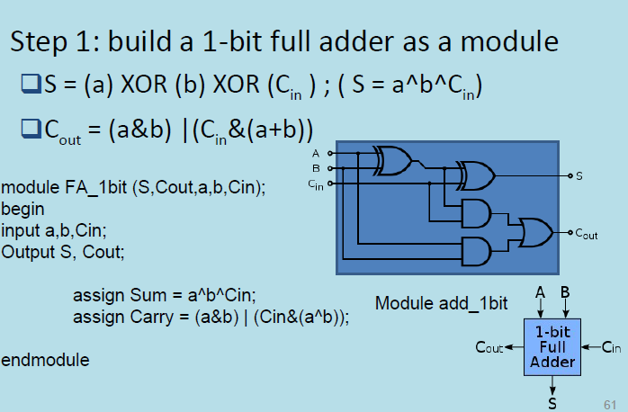
4-bit Ripple Carry Adder

Slide 9
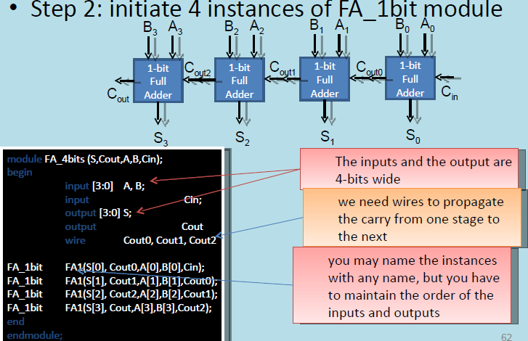
4-bit Ripple Carry Adder

Slide 10
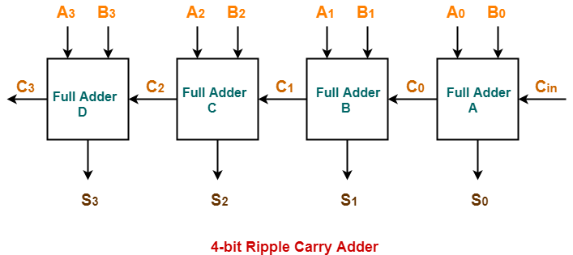

Slide 11
4-bit Ripple Carry Adder Verilog File rca.v
// Module 4-bit ripple carry adder
module fulladdR(input wire [3:0] a, b, input wire cin, output wire [3:0] sum, output wire cout);
// Instantiate full adder modules here
wire [2:0] c;
fulladd u0 (----------------------);
fulladd u1 (----------------------);
fulladd u2 (---------------------);
fulladd u3 (---------------------);
endmodule

Slide 12
4-bit Ripple Carry Adder Testbench rca_tb.v
`timescale 1 ns / 100 ps
`define TESTVECS 8
module tb;
reg clk, reset;
reg [3:0] i0, i1;
reg cin;
wire [3:0] o;
wire cout;
reg [8:0] test_vecs [0:(`TESTVECS-1)];
integer i;
initial
begin

Slide 13
$dumpfile("dump.vcd");
$dumpvars(0,tb);
end
initial
begin
reset = 1'b1;
#12.5 reset = 1'b0;
end
initial clk = 1'b0;
always #5
clk =~ clk;

Slide 14
initial begin
test_vecs[0] = 9'b000000000;
test_vecs[1] = 9'b000000010;
test_vecs[2] = 9'b000100010;
test_vecs[3] = 9'b011100010;
test_vecs[4] = 9'b000001110;
test_vecs[5] = 9'b011001111;
test_vecs[6] = 9'b001110011;
test_vecs[7] = 9'b111100011;
test_vecs[8] = 9'b011101110;
end
initial {i0, i1, cin, i} = 0;
fulladdR u0 (i0, i1, cin, o, cout);
initial begin
#6 for(i=0;i<` TESTVECS; i=i+1)
begin #10 {i0, i1, cin}=test_vecs[i];
end #100 $finish;
end endmodule

Slide 15
Program 2.(Ripple carry adder)
Students have to complete rca.v and fill the truth table
Execute the files basicfa.v, rca.v and rca_tb.v as mentioned below
Step1) iverilog -o testrca basicfa.v rca.v rca_tb.v
If the compilation went OK, you won't see any output.
Step2) vvp testrca
You can observe output on the console
Step3) gtkwave rca_test.vcd
Output waveform will be observed

Slide 16
4-bit Ripple Carry Adder Truth Table
a3 | a2 | a1 | a0 | b3 | b2 | b1 | b0 | cin
I0[3] | I0[2] | I0[1] | I0[0] | I1[3] | I1[2] | I1[1] | I1[0] | cin | O0[3] | O0[2] | O0[1] | O0[0] | cout
0 | 0 | 0 | 0 | 0 | 0 | 0 | 0 | 0 |  |  |  |  |  | 0+0=
0 | 0 | 0 | 0 | 0 | 0 | 0 | 1 | 0 |  |  |  |  |  | 0+1=
0 | 0 | 0 | 1 | 0 | 0 | 0 | 1 | 0 |  |  |  |  |  | 1+1=
0 | 1 | 1 | 1 | 0 | 0 | 0 | 1 | 0 |  |  |  |  |  | 7+1=
0 | 0 | 0 | 0 | 0 | 1 | 1 | 1 | 0 |  |  |  |  |  | 0+7=
0 | 1 | 1 | 0 | 0 | 1 | 1 | 1 | 0 |  |  |  |  |  | 6+7=
0 | 0 | 1 | 1 | 1 | 0 | 0 | 1 | 1 |  |  |  |  |  | 3+9+1=
1 | 1 | 1 | 1 | 0 | 0 | 0 | 1 | 1 |  |  |  |  |  | F+1+1=
0 | 1 | 1 | 1 | 0 | 1 | 1 | 1 | 0 |  |  |  |  |  | 7+7=

